Slide 1
Intelligent Notification System
A smart way of getting notified!

Slide 2
LAST ITERATION OVERVIEW
New Features
Edit Preferences
Register Events
MyEvents
Notification
Improvised Features
Add Preferences
Architecture (lowered coupling)

Slide 3
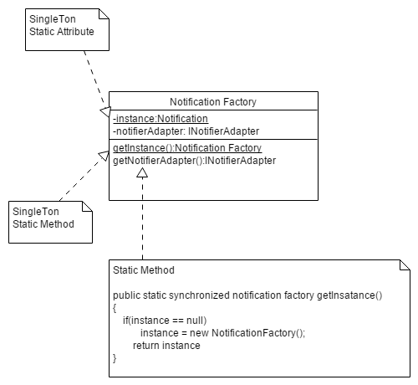
DESIGN PATTERN
Adapter Pattern (INotifierAdapter)
Factory Pattern (NotificationFactory)
Singleton Pattern (NotificationFactory)

Slide 4
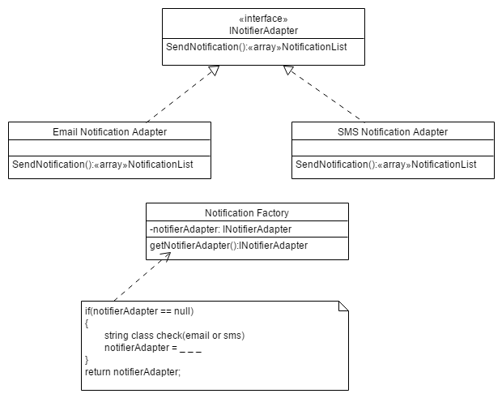
DESIGN PATTERN

Slide 5
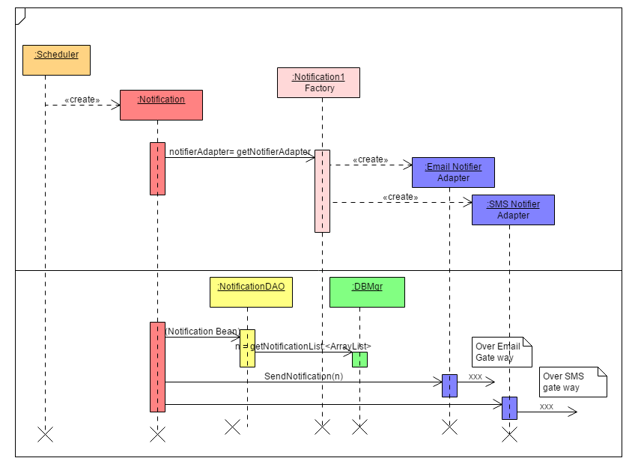
SEQUENCE DIAGRAM – NOTIFICATION (SMS AND EMAIL)

Slide 6
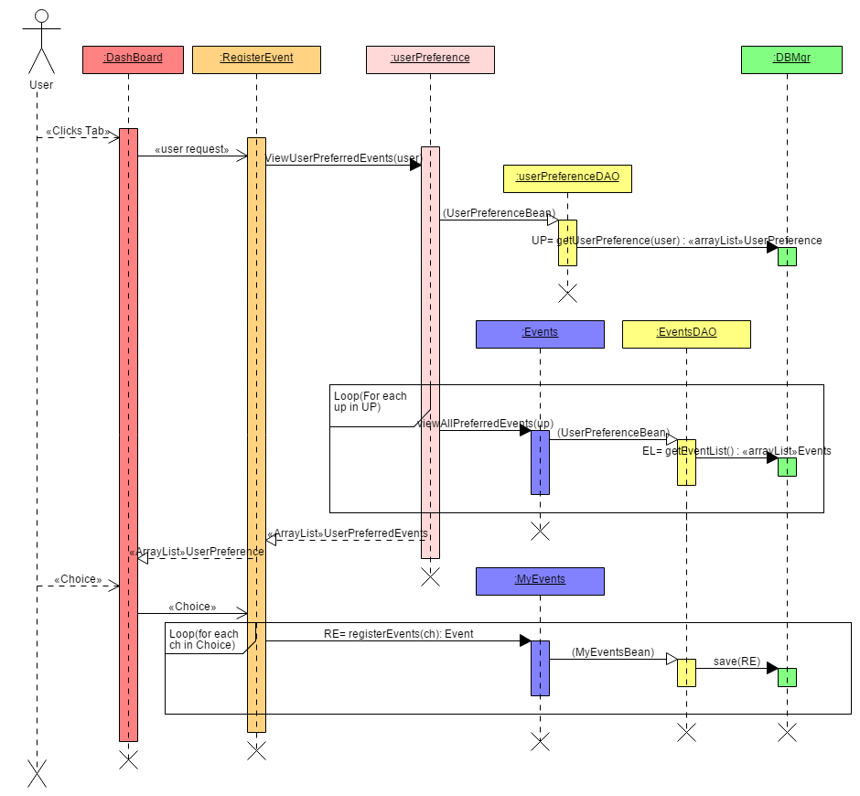
SEQUENCE DIAGRAM – NOTIFICATION (register events)

Slide 7
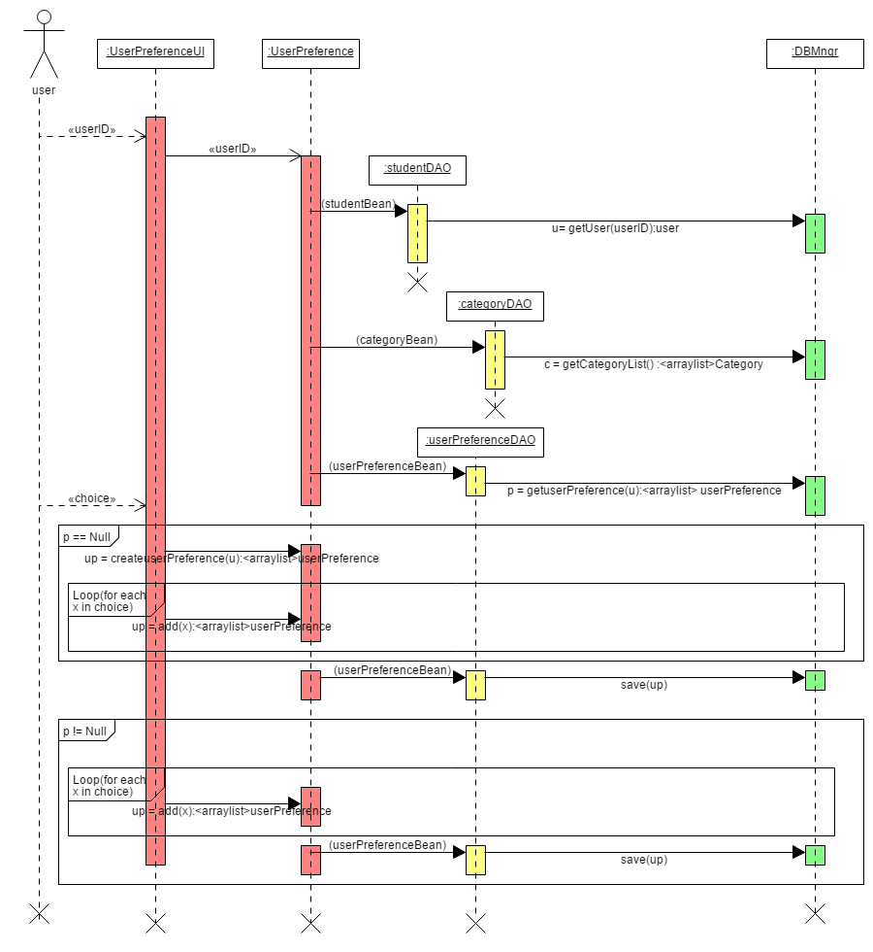
SEQUENCE DIAGRAM – NOTIFICATION (edit preferences)

Slide 8
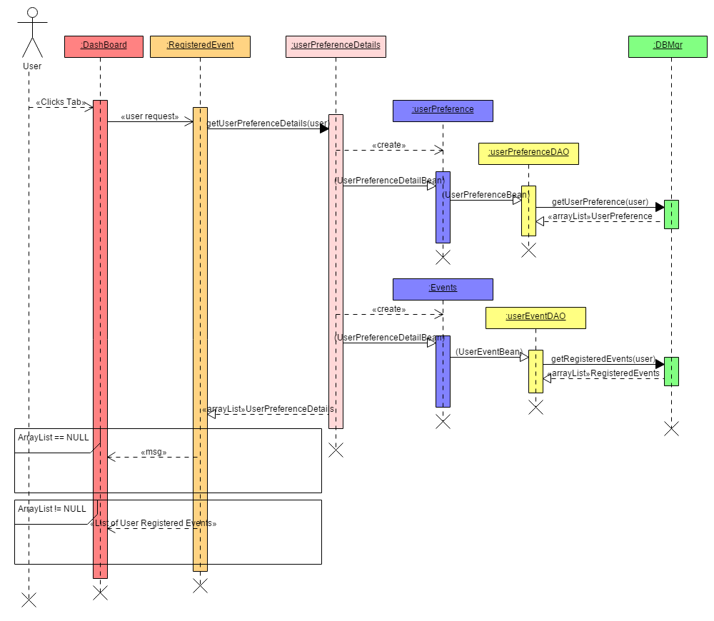
SEQUENCE DIAGRAM – NOTIFICATION (my events)

Slide 9
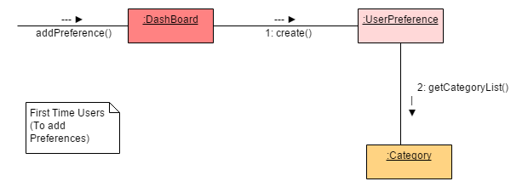
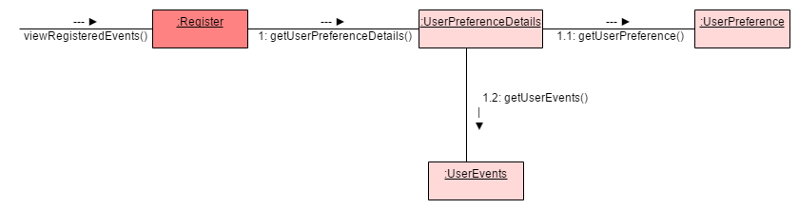
COMMUNICATION DIAGRAM
1. Add Preference
2.View Registered Events

Slide 10
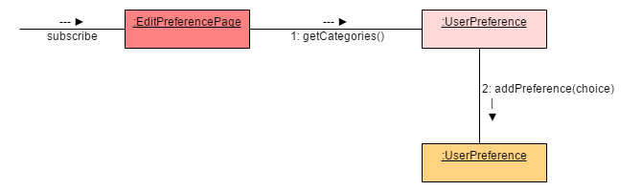
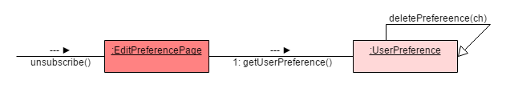
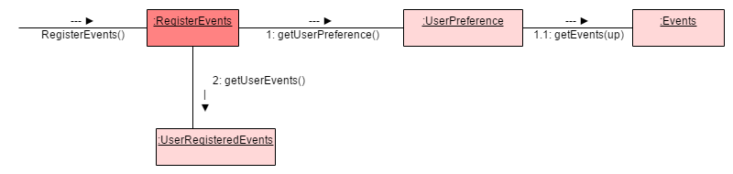
COMMUNICATION DIAGRAM (contd.)
3. Subscribe to a Category
4. Unsubscribe from a Category
5. Register Events

Slide 11
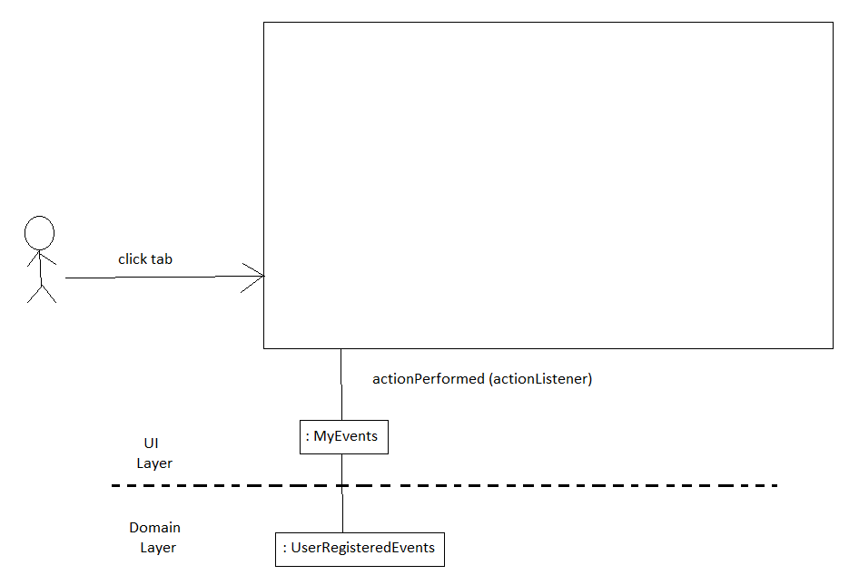
SEPARATION OF LAYERS

Slide 12
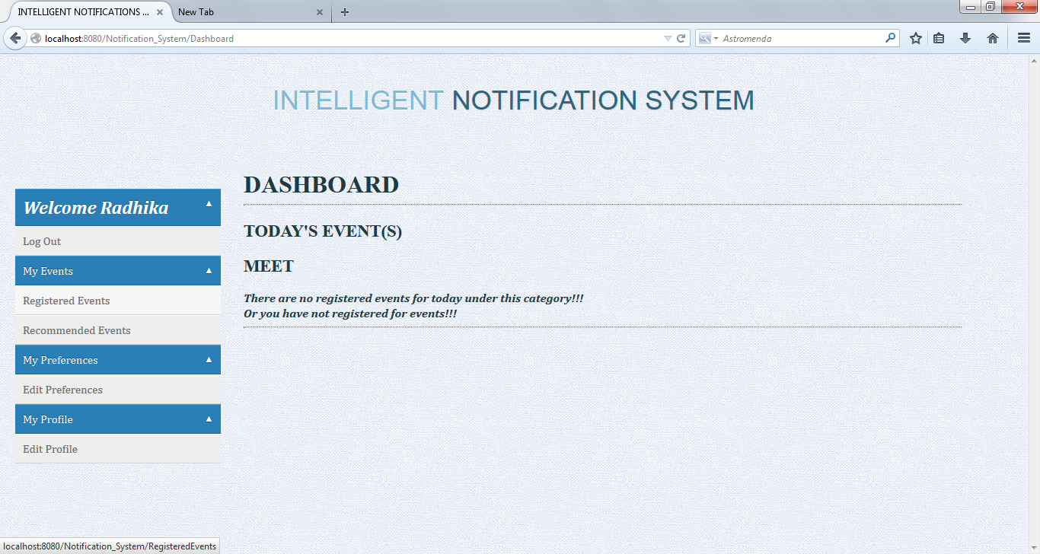
SCREEN SHOT OF DASHBOARD

Slide 13
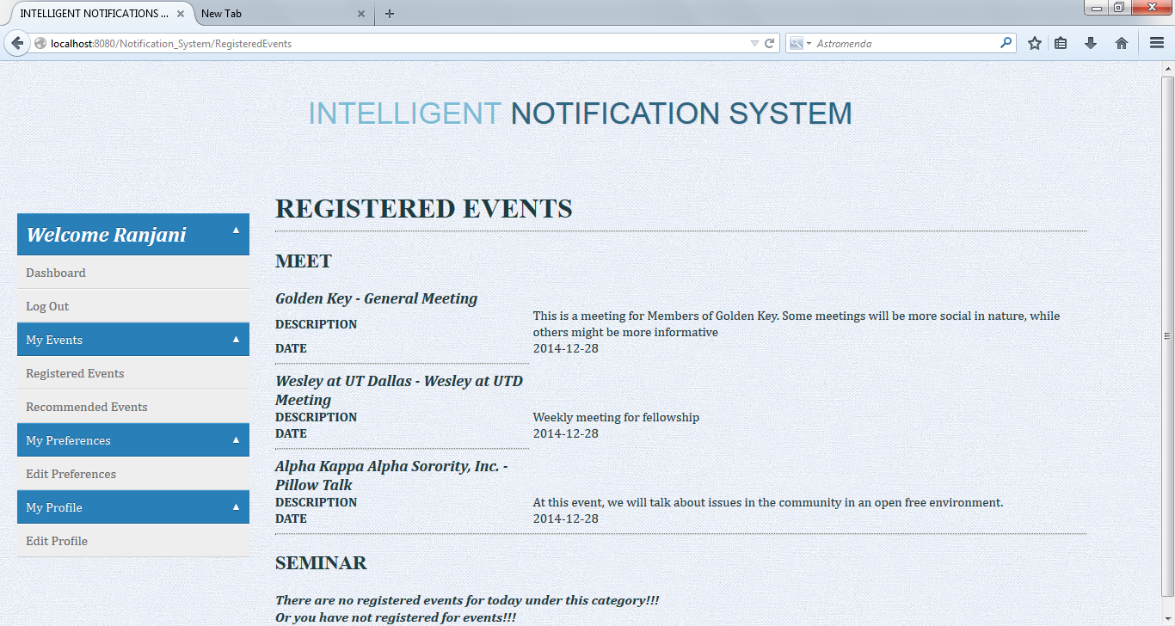
SCREENSHOT OF REGISTER EVENTS

Slide 14
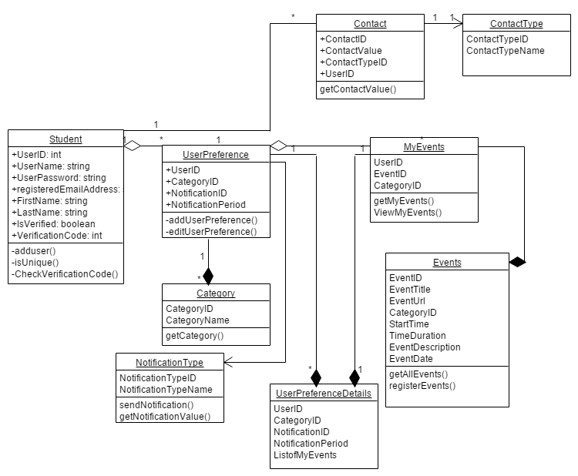
DESIGN DIAGRAM

Slide 15
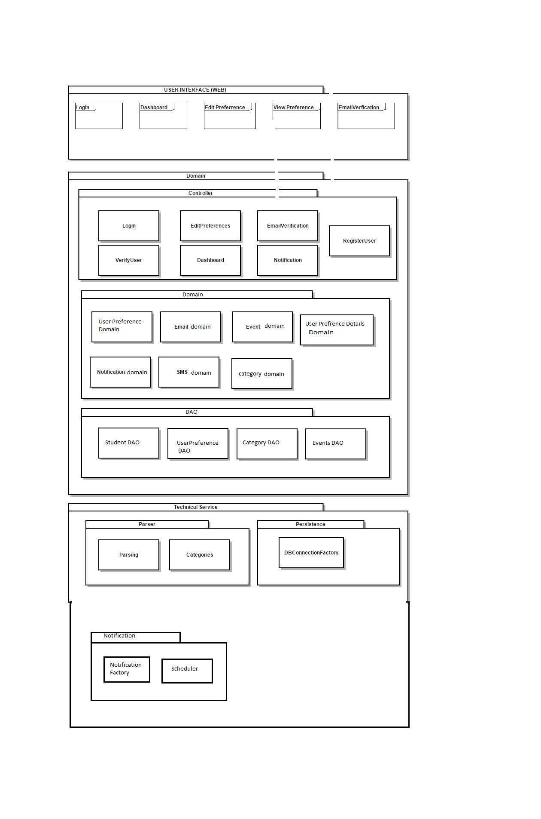
PACKAGE DIAGRAM

Slide 16
GOALS SET & GOALS ACHIEVED
Goals Set
Present to the user an extensive hierarchy of events
Provide the user suggestions or conflict information for any event
Provide the user the flexibility of notification selection
Goals Achieved
We managed to present the users events from the UTD comet calendar only.
We provide the user information regarding events that he may be interested for in the Register event section. However the conflict management is not handled
We provide flexibility to user to receive notification for the events based on hi preferred time interval and notification mode

Slide 17
CHALLENGES FACED & LESSONS LEARNT
Due to the high modularity between layers and extensive hierarches of events our project became complex
Huge redesign and improvisation in Iteration 2
WHAT WE LEARNT
Reduce the number of layers and hierarchies that made the project much simpler
Since we had to work on improvising our design we got a better insight of the design and we were successful in identifying the design patterns applicable to our project. This reduced coupling and made the code easy to reuse and maintain.
In iterative model we can always improvise on our project in any iteration. As such we get an efficient product

